Slide 1
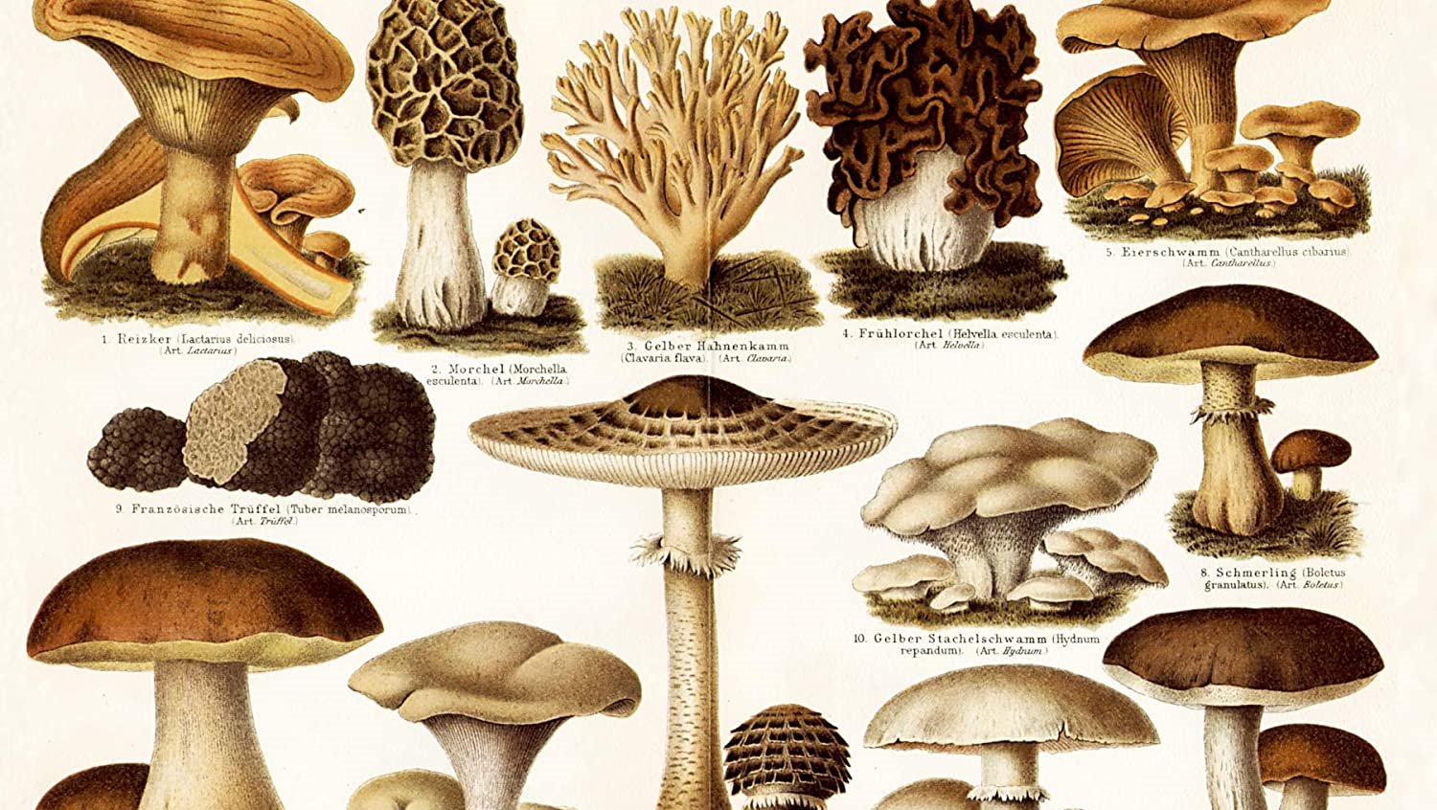
Wild Mushroom identification
Project and presentation by Cate Merfeld

Slide 2
Overview
Mushroom basics
Problem statement
The data
Preprocessing and modeling
Results
Next steps and questions

Slide 3
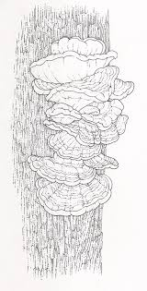


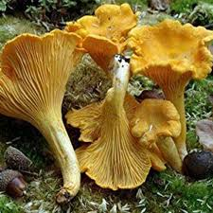
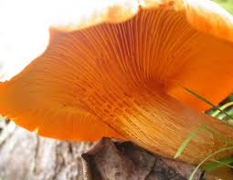
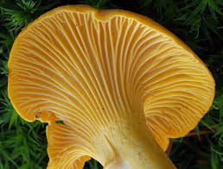
Mushroom Basics: Identification

Slide 4
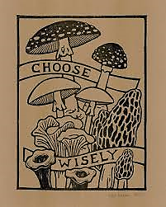
Identification:
Can be difficult, even with experience
Often requires research
Sometimes impossible without internet

Slide 5
Problem Statement
Mushroom identification applications currently available do not meet the needs of mushroom foragers, who are often trying to identify their finds without internet.
Training a light-weight neural network to classify images of mushrooms as either poisonous or edible could solve this problem.

Slide 6
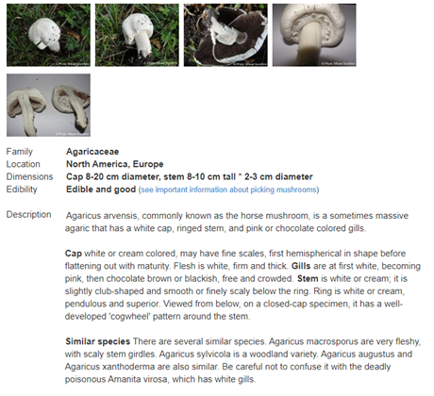
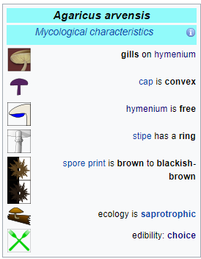
contextual data

Slide 7
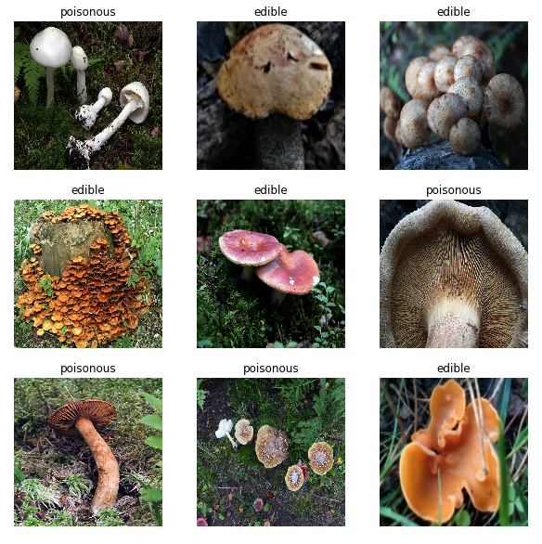
IMAGE DATA
Labeled images scraped from four reliable sites:
Mushroom World
Luonto Portti
Wild Food UK
Foraging Guide
Over 3,400 edible mushroom images, about 2,500 poisonous images.

Slide 8
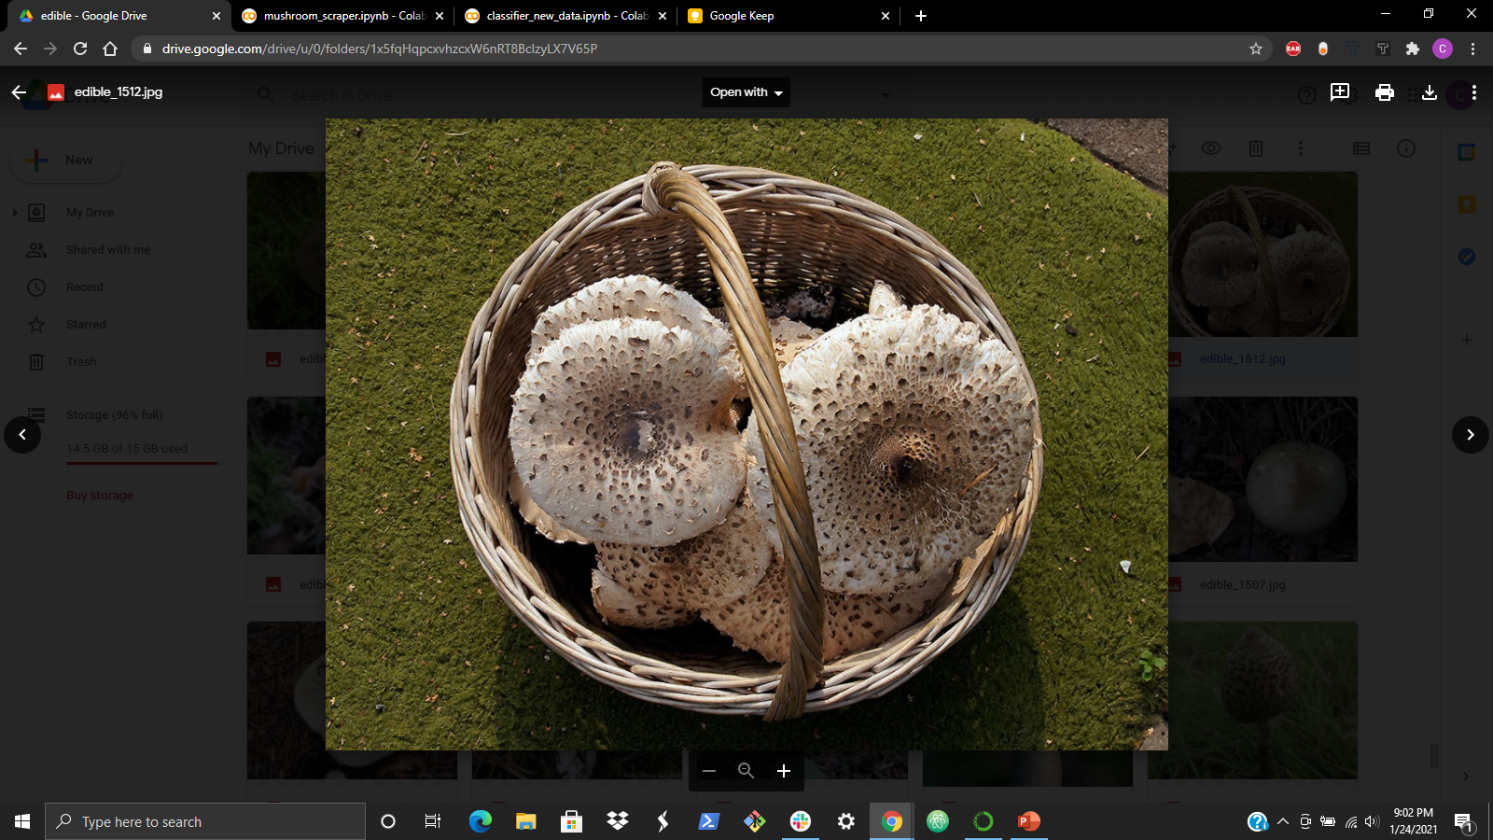
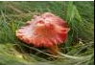
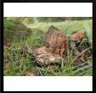
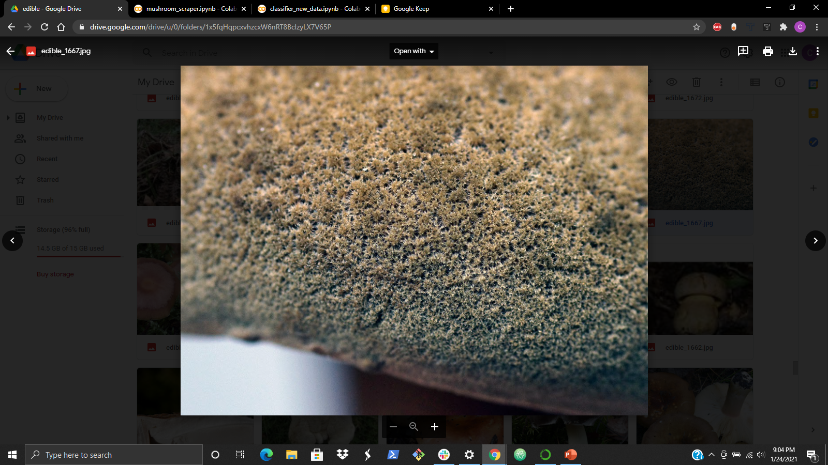
PREPROCESSING DATA CLEANING
Each image checked for:
Size
Subject
Focus
After cleaning:
3,100 edible images
2,250 poisonous images

Slide 9
Working With Small Datasets
Obstacles
Strategies
Dataset not ideal for deep learning
Many types of mushroom in each category
Only about 35 images per mushroom variety
Data augmentation
Transfer learning

Slide 10
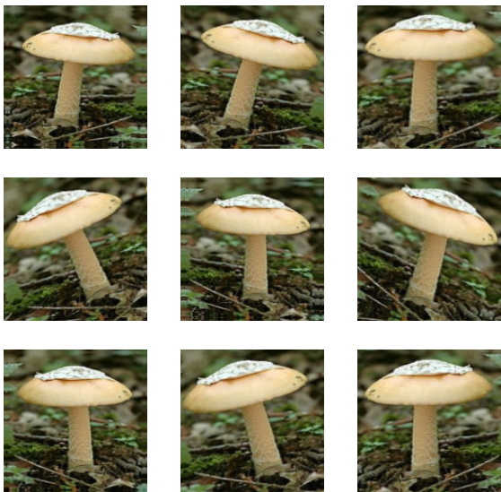
Data Augmentation
Artificially generate data by altering each training image
Typically improves model performance

Slide 11
Transfer Learning
Input
Input
Input
Convolutional Base
Train entire model
Freeze convolutional base
Freeze some layers and train the rest
Classifier
Prediction
Prediction
Prediction

Slide 12
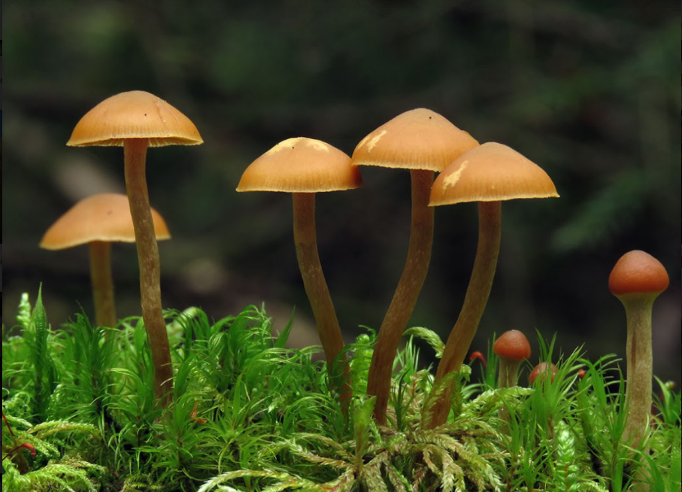
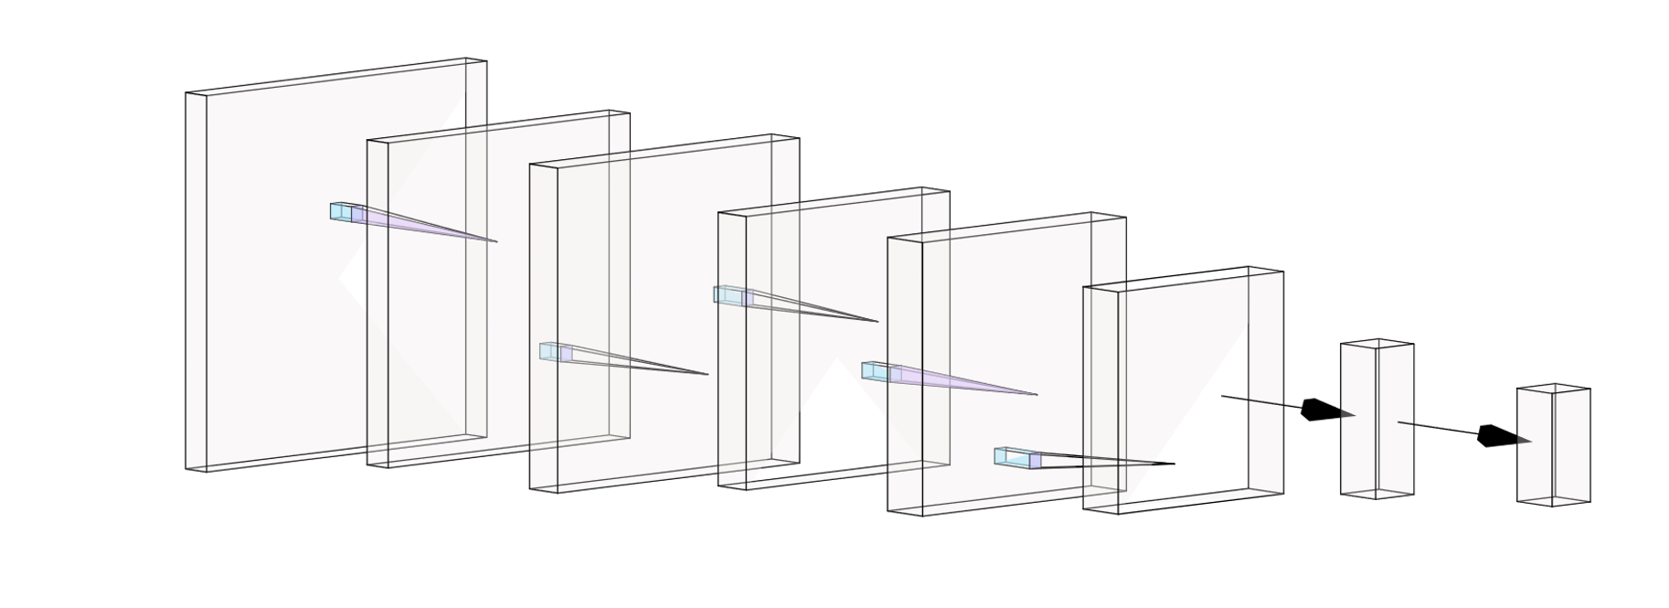
MODELING CONVOLUTIONAL NEURAL NETWORK
Max-Pool
Max-Pool
Max-Pool
Dense
Convolution
Convolution
Convolution
Flatten

Slide 13
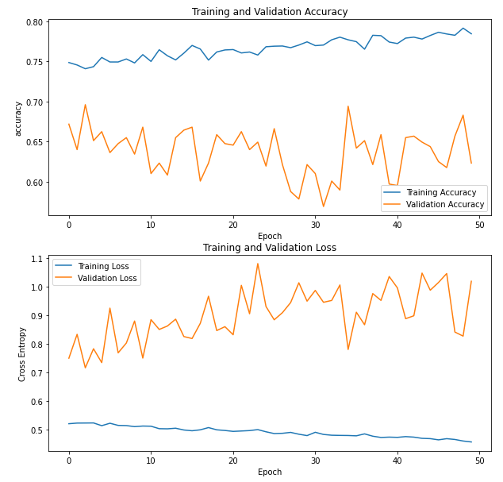
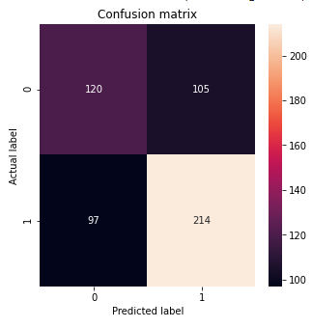
Model 1 CNN trained from scratch

Slide 14
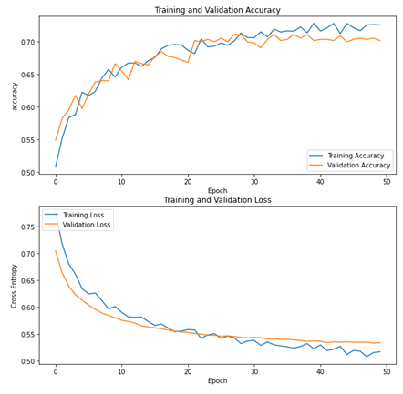
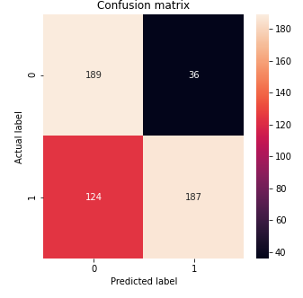
Model 2 MobileNetV2 – Frozen Convolutional Base

Slide 15
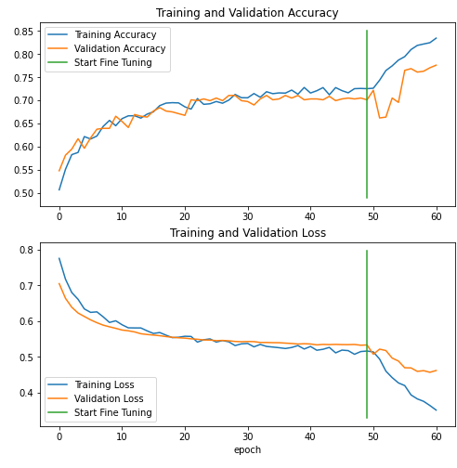
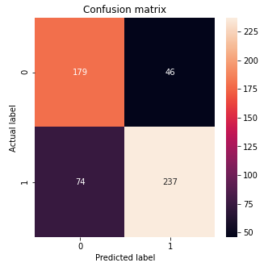
Model 3 MobileNetV2 – Fine Tuned

Slide 16
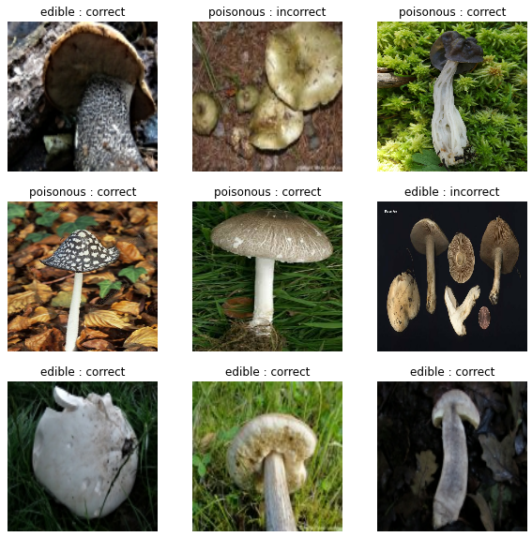
Model 2’s predictions on new data

Slide 17
Next Steps
Contextual data
Classification by variety
Smartphone app

Slide 18
Questions?

Slide 19
Thank you!

